Slide 1
Week 3
Rosa Maleki​

Slide 2

Validating 2d data using convolution
The average difference between mask and signals in both channels

Slide 3
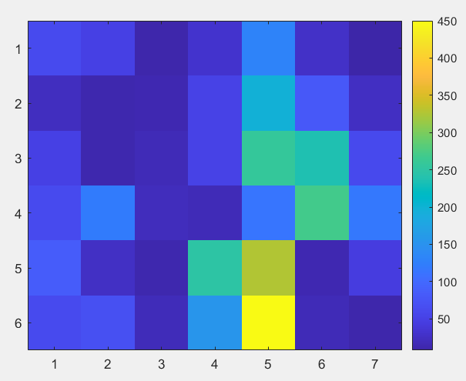
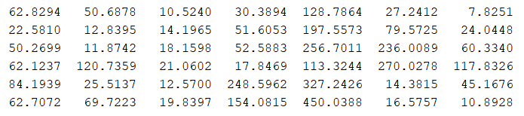
Validating 4d data using convolution
The map of difference in one channel

Slide 4


Validating 2d data using correlation
The average difference between mask and signals in both channels.
1-average(correlation):

Slide 5
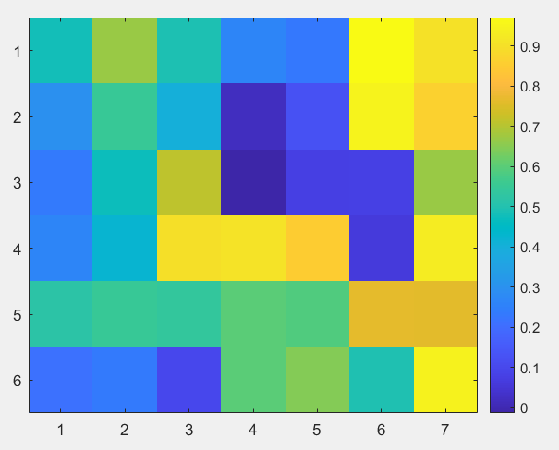
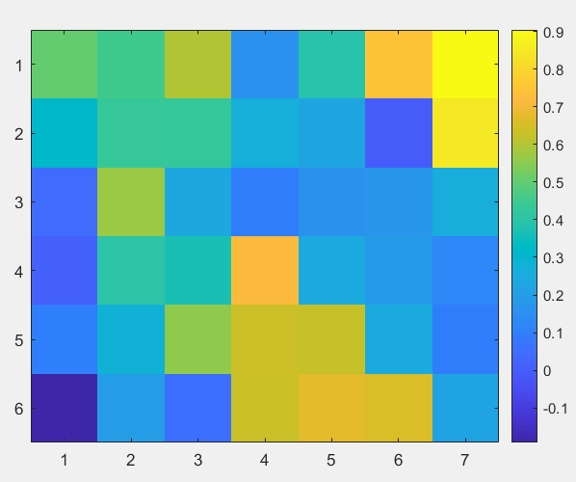
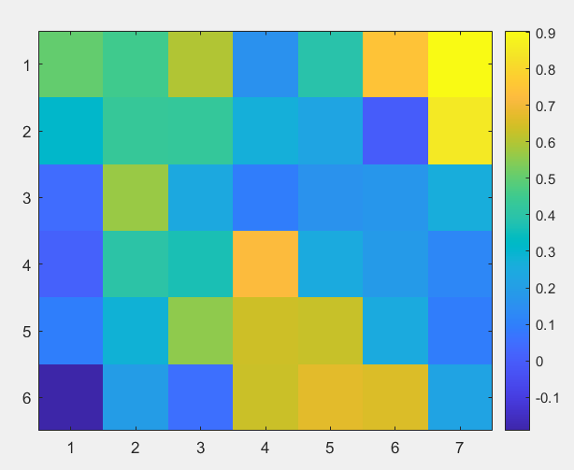
Validating 4d data using correlation

